Slide 1




Risk Assessment and Mitigation
Your Trusted Shield is Us

Slide 2
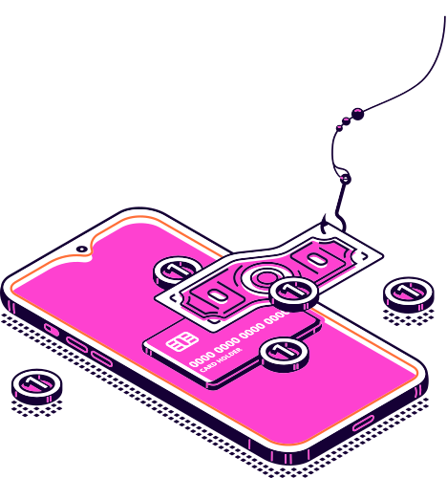
The main findings
1- Basic user with no access authority, can duplicate any pre-built dashboard
4/7
7/7
5/7
Threat rate
Misuse rate
Consequences
2- Basic user with lowest privileges can duplicate any Private dashboard
6/7
7/7
7/7
Threat rate
Misuse rate
Consequences

Slide 3




Some impacts
Network Security
Data Protection
How could a malicious user exploit this?
malicious user could be able to access private data
breaking the confidentiality and edit the private data as desired without supervision
Potential Threat
Loss trust
this misconfiguration may lead to data breach for potitional competitors
Customers may lose trust in the platform if unauthorized access to their resources is discovered

Slide 4

Safeguard your data
01.
Prevention
Always prevent the access by default
Protect your valuable data from being exposed, corrupted and misused
02.
avoidance
avoid using sequential numeric IDs in URLs
03.
Role-Based Access Control
Implement strict RBAC policies to ensure users only have access to resources necessary for their role.

Slide 5
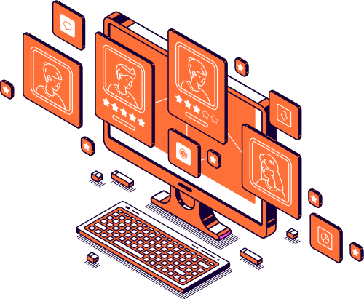
Essential steps should be taken
Provide training for developers on secure coding practices, particularly regarding access controls.
Make sure that your team is aware with the latest attack scenarios, vulnerabilities and weakness in the different technologies
24/7 threat monitoring must applied
implementation of Regular Updates and Patch Management
Code Reviews and Security Testing must always be applied
Always enforce access controls on the server side.

Slide 6

Get protected today and everday!
Created by
The Penetration testing team of the future
Mohamed Ali
Nada Elhadad
Mohamed abdaziz
Farida Talaat
Eman Ahmed
The detailed report

